Slide 1
Shareable Data Structures
Malcolm crowe
20 January 2019

Slide 2
Shareable data structures
Data Structures are in all Computing courses
Revisited when student has reached Threading
Threading examples show need for locking
Students learn this is why strings are immutable
At least in C# and Java – “value semantics”
But why do we use unsafe data structures?
In this lecture we focus on SAFE data structures
For sharing and copying between threads
The reduces the need for complex locking

Slide 3
What is unsafe?
Example: Arrays A and B (in Java, say)
After B=A we have
Then A[2]=‘T’ gives
(correct, maybe?)
A safe array would give
A=A.Set(2,’T’)
Change is just to A

Slide 4
We learn about cloning?
A concept often not grasped by students
When a list is passed “by value” to a proc
There is nothing to stop the proc changing it
With value semantics this shouldn’t occur
So maybe we need to stop using lists!
Immutable strings are still useful, so
Make data structures have immutable contents
We will still need locking for mutable things
We keep it to a minimum to simplify our design

Slide 5
In database technology
Once we have enough structures
We can build a full DBMS (e.g. StrongDBMS)
Taking a snapshot is as easy as B=A above
People with copies can consider changes
On ROLLBACK changes can simply be forgotten
For B=A example, simply restore by A=B
On COMMIT we need to check for conflicts
And the DBMS can accept the changes in master copy
The list of master copies of databases in use
Might be the DBMS’ only unsafe data structure!

Slide 6

Example: a safe linked list
After B=A suppose we have linked list (56,24)
For a safe list, A=A.InsertAt(1,31) gives:
Coloured nodes are new
Then A=A.RemoveAt(0):
Note B still has the old list
A:
56
31
B:
56
24
A:
31
B:
56
24

Slide 7
Implementation in Java
Shareable data structures have all fields public final
So a safe linked list of integers might be:
public class SListOfInt {
public final int element;
public final SListOfInt next;
//.. And we need at least one constructor
// and the methods InsertAt, RemoveAt
}

Slide 8
Memory blocks are shared
Thinking about the shareable linked-list
The versions share nodes after the change
Similarly for a shareable tree structure
For each change the new nodes are a path
From the root to the nodes that were changed
More complex data structures are better
Even more efficient since more is shared
Contrast with mutable structures
Where the whole thing needs to be cloned

Slide 9
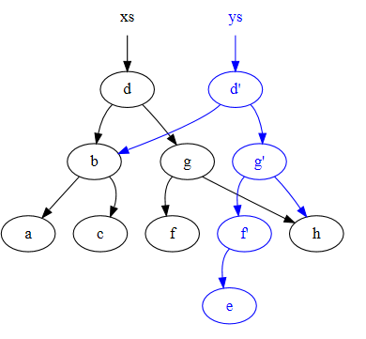
How new is this?
“Persistent Data Structures”
“Multi-version”, “Concurrent” etc
These have a similar idea, but a fatal flaw
A mutable root node
“Purely functional” is better
See Okasaki 1996
Wikipedia shows this:
Which is exactly right.

Slide 10
Is it faster?
The memory allocator works harder
But we avoid recursive copying
Top parts of structures are cheapest to change
Cheapest of all are stacks
Structures such as queues are expensive
Since we always add at the end
This affects speed of breadth-first search
This would be something worth analysing

Slide 11
Bookmark replaces Iterator
Iterators are popular for traversing structures
Used internally to implement foreach
But they are not shareable
And prevent change to the structure traversed
A Bookmark starts with snapshot of structure
Bookmark b=S.First()
Shareable, traverses using b=b.Next()
for (var b=S.First(); b!=null; b=b.Next())
Just as efficient (memory allocator works harder)

Slide 12
Towards StrongDBMS
Too much locking is a real pain
DBMS (claim they) use locking all the time
Deadlocks are a plague and very hard to avoid
Normally detected by inactivity!
Pyrrho DBMS uses optimistic execution
Locks and checks everything only during commit
Uses shareable data structures for trees, rows
StrongDBMS uses them for most things
Especially the database and transaction objects

Slide 13
StrongDBMS so far
Every change changes at two levels:
The in-memory versions of the indexes (etc)
The new objects the transaction knows about
It is a bit confusing to program
A C# constructor for each kind of change
Always get from one consistent state to next
Many constructors have a stream parameter
The stream of data from the client socket
The FileStream for the transaction log

